Slide 1
Project Group Guidelines for INT219 and INT220
Instructions for Group Formation and Google Form Submission

Slide 2
Overview
Objective:
To ensure proper and systematic group formation for the INT219 and INT220 project, involving front-end and back-end development.
Key Focus Areas:
1. Group formation within sections.
2. Ensuring accurate Google Form submission.
3. Adherence to guidelines for a smooth process.

Slide 3
Same Section Groups
Guidelines for Group Formation:
- Students must form groups within the same section.
- Cross-section groups are not allowed.
Why is this important?
- To ensure smooth communication and collaboration within the group.
- Aligns with faculty supervision within sections.

Slide 4
Common Project Details
Project Scope:
- A combination of front-end and back-end development.
- Relevant for both INT219 and INT220 courses.
Expectations:
- Integrate concepts learned in class.
- Option for revenue-generating projects available.

Slide 5
Google Form Instructions
Filling the Google Form:
1. Team Leader Responsibility:
- Each group must designate a leader to complete the form.
2. Details to be Submitted:
- Names and roll numbers of all team members (filled by team Leader only)- Section details.
3. Accuracy is Key:
- Ensure all information is filled correctly and carefully.

Slide 6
Submission Guidelines
Important Rules:
1. No Changes Post-Submission:
- Once submitted, groups cannot be altered.
2. One Submission per Group:
- Only the team leader is allowed to submit the form.
- Multiple submissions from the same group will not be accepted.
3. Revenue-Generation Projects:
- Individual submissions allowed for students opting for revenue-generation projects.

Slide 7
Key Points to Remember
- Group formation within the same section.
- Accurate and complete details must be submitted in the Google Form.
- One submission per group by the team leader.
- No changes allowed post-submission.
- Revenue-generation project submissions can be individual.

Slide 8
Faculty Responsibilities
Role of Faculty Members:
- Discuss these guidelines with students.
- Guide students on forming groups and completing the process.
- Clarify doubts and ensure adherence to the instructions.

Slide 9
Thank You
Thank You for Your Attention!
Let’s ensure a smooth and successful project process for INT219 and INT220.

Slide 10
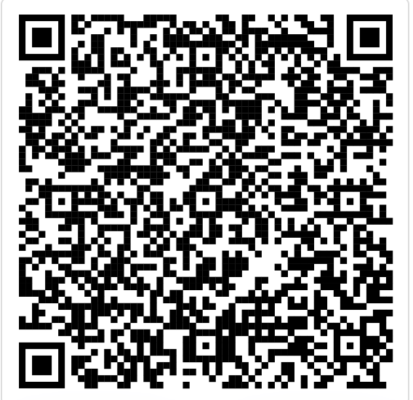
LINK FOR PROJECT GROUP CREATION

